Slide 1
Algorithms and Data Structures
Lecture VI
Simonas Šaltenis
Nykredit Center for Database Research
Aalborg University
simas@cs.auc.dk

Slide 2
This Lecture
Dictionary ADT
Hashing
  the concept
  collision resolution
  chooing a hash function
  advanced collision resolution

Slide 3
Dictionary
Dictionary ADT – a dynamic set with methods:
  Search(S, k) – an access operation that returns a pointer x to an element where x.key = k
  Insert(S, x) – a manipulation operation that adds the element pointed to by x to S
  Delete(S, x) – a manipulation operation that removes the element pointed to by x from S
An element has a key part and a satellite data part

Slide 4
Dictionaries
Dictionaries store elements so that they can be located quickly using keys
A dictionary may hold bank accounts
  each account is an object that is identified by an account number
  each account stores a wealth of additional information
    including the current balance,
    the name and address of the account holder, and
    the history of deposits and withdrawals performed
  an application wishing to operate on an account would have to provide the account number as a search key

Slide 5
Dictionaries (2)
Supporting order (methods min, max, successor, predecessor ) is not required, thus it is enough that keys are comparable for equality

Slide 6
Dictionaries (3)
Different data structures to realize dictionaries
  arrays, linked lists (inefficient)
  Hash table (used in Java...)
  Binary trees
  Red/Black trees
  AVL trees
  B-trees
In Java:
  java.util.Dictionary – abstract class
  java.util.Map – interface

Slide 7
The Problem
RT&T is a large phone company, and they want to provide caller ID capability:
  given a phone number, return the caller’s name
  phone numbers range from 0 to r = 10⁸ -1
  want to do this as efficiently as possible

Slide 8
The Problem
A few suboptimal ways to design this dictionary
  direct addressing: an array indexed by key:
    takes O(1) time,
    O(r) space - huge amount of wasted space
  a linked list: takes O(n) time, O(n) space
(null) | (null) | Jens Jensen | (null) | (null)
0000-0000 | 0000-0000 | 9635-8904 | 0000-0000 | 0000-0000
Jens Jensen
Ole Olsen
9635-8904
9635-9999

Slide 9
Another Solution
We can do better, with a Hash table -- O(1) expected time, O(n+m) space, where m is table size
Like an array, but come up with a function to map the large range into one which we can manage
  e.g., take the original key, modulo the (relatively small) size of the array, and use that as an index
Insert (9635-8904, Jens Jensen) into a hashed array with, say, five slots
  96358904 mod 5 = 4
(null) | (null) | (null) | (null) | Jens Jensen
0 | 1 | 2 | 3 | 4

Slide 10
Another Solution (2)
A lookup uses the same process: hash the query key, then check the array at that slot
Insert (9635-8900, Leif Erikson)
And insert (9635-8004, Knut Hermandsen).
(null) | (null) | (null) | (null) | Jens Jensen
0 | 1 | 2 | 3 | 4

Slide 11
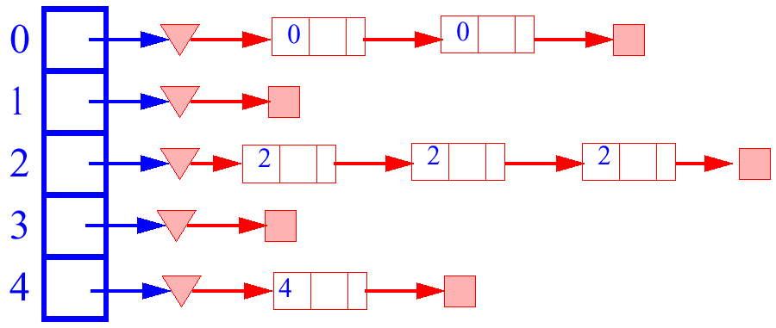
Collision Resolution
How to deal with two keys which hash to the same spot in the array?
Use chaining
  Set up an array of links (a table), indexed by the keys, to lists of items with the same key
  Most efficient (time-wise) collision resolution scheme

Slide 12
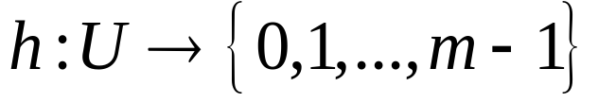
Analysis of Hashing
An element with key k is stored in slot h(k) (instead of slot k without hashing)
The hash function h maps the universe U of keys into the slots of hash table T[0...m-1]
Assumption: Each key is equally likely to be hashed into any slot (bucket); simple uniform hashing
Given hash table T with m slots holding n elements, the load factor is defined as α=n/m
Assume time to compute h(k) is Θ(1)

Slide 13
Analysis of Hashing (2)
To find an element
  using h, look up its position in table T
  search for the element in the linked list of the hashed slot
Unsuccessful search
  element is not in the linked list
  uniform hashing yields an average list length α = n/m
  expected number of elements to be examined α
  search time O(1+ α) (this includes computing the hash value)

Slide 14
Analysis of Hashing (3)
Successful search
  assume that a new element is inserted at the end of the linked list
  upon insertion of the i-th element, the expected length of the list is (i-1)/m
  in case of a successful search, the expected number of elements examined is 1 more that the number of elements examined when the sought-for element was inserted!

Slide 15
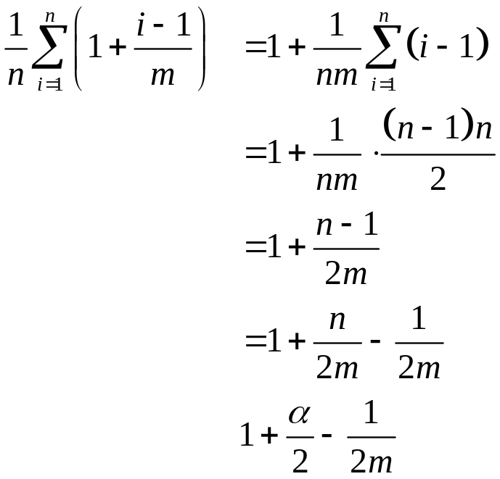

Analysis of Hashing (4)
The expected number of elements examined is thus
Considering the time for computing the hash function, we obtain

Slide 16


Analysis of Hashing (5)
Assuming the number of hash table slots is proportional to the number of elements in the table
  .
  .
  searching takes constant time on average
  insertion takes O(1) worst-case time
  deletion takes O(1) worst-case time when the lists are doubly-linked

Slide 17
Hash Functions
Need to choose a good hash function
  quick to compute
  distributes keys uniformly throughout the table
  good hash functions are very rare – birthday paradox
How to deal with hashing non-integer keys:
  find some way of turning the keys into integers
    in our example, remove the hyphen in 9635-8904 to get 96358904!
    for a string, add up the ASCII values of the characters of your string (e.g., java.lang.String.hashCode())
  then use a standard hash function on the integers

Slide 18
HF: Division Method
Use the remainder
  h(k) = k mod m
  k is the key, m the size of the table
Need to choose m
m = b^{e} (bad)
  if m is a power of 2, h(k) gives the e least significant bits of k
  all keys with the same ending go to the same place
m prime (good)
  helps ensure uniform distribution
  primes not too close to exact powers of 2

Slide 19
HF: Division Method (2)
Example 1
  hash table for n = 2000 character strings
  we don’t mind examining 3 elements
  m = 701
    a prime near 2000/3
    but not near any power of 2
Further examples
  m = 13
    h(3)?
    h(12)?
    h(13)?
    h(47)?

Slide 20
HF: Multiplication Method
Use
  h(k) = ⎣m (k A mod 1) ⎦
  k is the key, m the size of the table, and A is a constant
  0 < A < 1
The steps involved
  map 0...k_{max} into 0...k_{max} A
  take the fractional part (mod 1)
  map it into 0...m-1

Slide 21
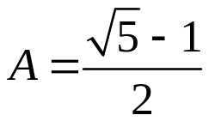
HF: Multiplication Method(2)
Choice of m and A
  value of m is not critical, typically use m = 2^{p}
  optimal choice of A depends on the characteristics of the data
    Knuth says use (conjugate of the golden ratio) – Fibonaci hashing

Slide 22
Universal Hashing
For any choice of hash function, there exists a bad set of identifiers
A malicious adversary could choose keys to be hashed such that all go into the same slot (bucket)
Average retrieval time is Θ(n)
Solution
  a random hash function
  choose hash function independently of keys!
  create a set of hash functions H, from which h can be randomly selected

Slide 23
Universal Hashing (2)
A collection H of hash functions is universal if for any randomly chosen f from H (and two keys k and l), Pr{f(k) = f(l)} ≤ 1/m

Slide 24
More on Collisions
A key is mapped to an already occupied table location
  what to do?!?
Use a collision handling technique
We’ve seen Chaining
Can also use Open Addressing
  Probing
  Double Hashing

Slide 25

Open Addressing
All elements are stored in the hash table (can fill up!), i.e., n ≤ m
Each table entry contains either an element or null
When searching for an element, systematically probe table slots
Modify hash function to take the probe number i as the second parameter
Hash function, h, determines the sequence of slots examined for a given key

Slide 26
Open Adressing (2)
Probe sequence for a given key k given by

Slide 27
Linear Probing
If the current location is used, try the next table location
Lookups walk along the table until the key or an empty slot is found
Uses less memory than chaining
  one does not have to store all those links
Slower than chaining
  one might have to walk along the table for a long time
LinearProbingInsert(k)
01 if (table is full) error
02 probe = h(k)
03 while (table[probe] occupied)
04 probe = (probe+1) mod m
05 table[probe] = k

Slide 28
Linear Probing
A real pain to delete from
  either mark the deleted slot
  or fill in the slot by shifting some elements down
Example
  h(k) = k mod 13
  insert keys: 18 41 22 44 59 32 31 73

Slide 29
Double Hashing
Use two hash functions
If m is prime, eventually will examine every position in the table
Many of the same (dis)advantages as linear probing
Distributes keys more uniformly than linear probing
DoubleHashingInsert(k)
01 if (table is full) error
02 probe = h1(k)
03 offset = h2(k)
03 while (table[probe] occupied)
04 probe = (probe+offset) mod m
05 table[probe] = k

Slide 30
Double Hashing (2)
h2(k) must be relative prime to m
Example
  h1(k) = k mod 13
  h2(k) = 8 - k mod 8
  insert keys: 18 41 22 44 59 32 31 73

Slide 31
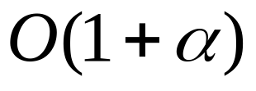

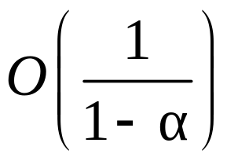
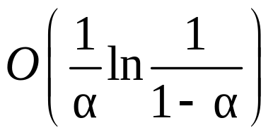
Expected Number of Probes
Load factor α < 1 for probing
Analysis of probing uses uniform hashing assumpion – any permutation is equally likely
  What about linear probing and double hashing?
 | unsuccessful | successful
chaining
probing

Slide 32
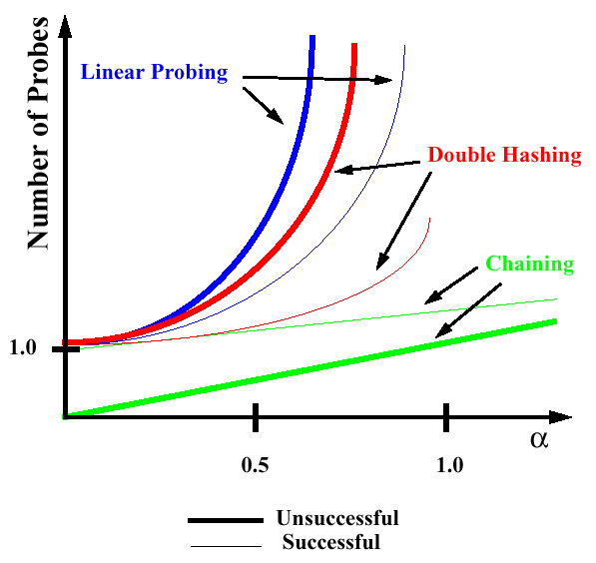
Expected Number of Probes (2)

Slide 33
The Hashing Class in Java
java.util.Hashtable
Constructor
  public Hashtable(int size, float load);
Accessor methods
  public Object put(Object key, Object value):
    maps the specified key to the specified value in this hashtable

Slide 34
Next Week
Binary Search Trees

